Slide 1
DRIVER+ Overview
EXTERNAL COOPERATION IN DRIVER+
Marcel van Berlo (TNO) & Michael Löscher (ARTTIC)
15 November 2017 – Tallinn, Estonia

Slide 2
DRIVER+ will seek to improve the way capability development and innovation management are tackled, by testing and validating (in realistic environments) solutions that are addressing the operational needs of practitioners dealing with Crisis Management.
Notes:
The challenges:
The scale and pace of crises pose enormous challenges for the Crisis Management (CM) sector, with new threats emerging all the time. An already complex field must also strive to integrate new technologies and methods, cope with a rapidly changing infrastructure, understand evolving risks, be effective across cultural, administrative and national boundaries and engage with populations to enhance their resilience. Innovation is therefore critical, but will only be successful if it is relevant and accessible to practitioners and operators. CM innovation must therefore be capable of meeting these multifaceted challenges and delivering solutions that are modular, flexible and adaptable. These solutions must be tested and validated in realistic environments; they must be evaluated to assess their true benefits and for their overall suitability, before being adopted by end-users. DRIVER+ (Driving Innovation in Crisis Management for European Resilience), funded under the European Union’s 7th Framework Programme will improve the way capability development and innovation management are addressed, by assessing and delivering solutions that can be used, and combined, to address different types of large-scale crises.
Why DRIVER+
In May 2014, dedicated practitioners’ organisations, research institutes, industries and SMEs teamed up to support the European Union to tackle this issue. Until April 2020 the broad aim of the DRIVER+ project, funded under the European Union’s 7th Framework Programme, will be to improve the way capability development and innovation management are addressed, by assessing and delivering solutions that can be used, and combined, to address different types of large-scale crises.

Slide 3



FROM DRIVER TO DRIVER+
WHAT HAS BEEN IMPROVED?
1
A REVISED AND SIMPLIFIED PROJECT STRUCTURE
2
A NEW LEADERSHIP AND CONSORTiUM MEMBERS
3
AN OPEN AND INCLUSIVE APPROACH
Turning objectives into tangible results
Reinforcing the project team
Enhanced involvement of external stakeholders

Slide 4



A PRACTITIONER-DRIVEN approach
From solution-driven to needs-driven
In order to provide a European answer to the challenges Crisis Management is facing today and tomorrow, the involvement of as many concerned stakeholders as possible is essential.
The selection of solutions to be tested within DRIVER+, should be provided by current partners and external organisations to extend the knowledge base. The process should be neutral and transparent, and both the review and selection should be driven by the end-users.

Slide 5
The objectives
To develop a pan-European Test-bed for Crisis Management
capability development
To develop a comprehensive Portfolio of Crisis Management Solutions
To facilitate a shared understanding in Crisis Management across Europe

Slide 6
OBJECTIVE 1: To develop a pan-European Test-bed for CM capability development
AN ARENA OF VIRTUALLY CONNECTED FACILITIES AND CRISIS LABS
Providing a pragmatic step-by-step guidance to conduct trials
Providing general guidance and the technical infrastructure of the Test-bed to support the trials
4.
1.
Providing a reference implementation for all DRIVER+ trials
3.
2.
Creating a demonstration infrastructure where stakeholders can collaborate in trialling and evaluating new tools, processes or organisational solutions

Slide 7
OBJECTIVE 2: To develop A PORTFOLIO OF CRISIS MANAGEMENT SOLUTIONS
A DATABASE-DRIVEN ONLINE CATALOGUE
Documenting and presenting details on solutions tested and evaluated during the DRIVER+ Trials
2.
3.
1.
Allowing for the introduction of third party solutions already used by practitioners or relevant to Crisis Management
Supporting the sharing of user experiences, and thereby, easing the successful implementation and usage of solutions for other practitioners

Slide 8
OBJECTIVE 3: To facilitate A SHARED UNDERSTANDING in CRISIS MANAGEMENT
ENHANCING THE COOPERATION FRAMEWORK
Cooperating with CM experts, practitioners and solution providers external to DRIVER+
Organising I4CM events (Innovation for Crisis Management) that bring together solution providers practitioners at local/regional level and relay the Community of Users on European level
4.
5.
1.
3.
Building and structuring a dedicated Community of Practice in Crisis Management to facilitate identification of best practises and sharing of lessons learnt
2.
Developing new standards and/or contributing to ongoing and future standard development
Organising 3 Policy-Research Roundtables to exchange with policy-makers on project results and potential EU policy implications

Slide 9
How will we reach the objectives?
TRIALS
Poland, France, Austria, The Netherlands
FINAL DEMO
Poland/Italy
To develop a pan-European Test-bed for Crisis Management capability development
To develop a comprehensive Portfolio of Crisis Management Solutions
To facilitate a shared understanding in Crisis Management across Europe

Slide 10
Trials
4 EVENTS TO OPERATIONALISE AND TEST
both THE SOLUTIONS and the test-bed components
Poland, France, Austria, The Netherlands
Based on updated Crisis Management gaps and practitioner needs
Benefiting from the DRIVER+ Test-bed components
All results to be made available in the Portfolio of Solutions

Slide 11

Final demonstration
1 EVENT TO Showcase THE SOLUTIONS, THEIR EFFICIENCY AND EU ADDED-VALUE
Italy and Poland
Building upon the results
of the trials and the lessons learnt from reference implementations and design validation of the Test-bed
Showcasing the benefits that DRIVER+ Solutions may represent for the Emergency Response Coordination Centre (ERCC) activities.
Presenting the potential of a more integrated high-level CM system in Europe

Slide 12
How will we increase the impact?
TRIALS
Poland, France, Austria, The Netherlands
FINAL DEMO
Poland/Italy
Test-bed
Portfolio of Solutions
I4CMs
Poland, Denmark
Shared understanding
EXTERNAL COOPERATION
An inclusive approach
POLICY-DIALOGUE
ROUNDTABLES
Poland, Denmark, Belgium

Slide 13



Innovation for crisis management (I4CM) events
UNIQUE LOCAL EXCHANGE FORUMS ON PRACTITIONERS’ NEEDS AND SOLUTIONS
Poland and Denmark
To address pressing regional issues to be solved, identify best practices, foster synergies, and address issues of common interest
To exchange on (future) needs of practitioners, already available promising solutions to address them and those that are still to be developed
To provide a relay towards the European level

Slide 14


POLICY-RESEARCH DIALOGUE ROUNDTABLES
Strengthening the Policy-Research Dialogue on research and demonstration activities in Crisis Management
Poland, Denmark and Belgium
Two before the trials and final demonstration to allow exchanges on the potential EU policies to be addressed and the involvement of DG HOME, DG ECHO /ERCC staff
One after the events to allow exchanges on the results and the potential policy implications

Slide 15































Notes:
The Who 1/3

Slide 16

External cooperation
The project opening up to the external worLD
Identify external innovative solution providers and interested practitioners
Enable their participation and direct technical contribution to DRIVER+ trials, to ensure their high quality, relevance and appropriateness

Slide 17
Participation of practitioners and solution providers
For what?
To identify and update needs and gaps in Crisis Management
To develop scenarios as a basis for the DRIVER+ trials
To integrate solutions for the trials
To prepare and conduct the trials
To evaluate the solutions and derive lessons learnt
To participate in workshops, conferences and dialogue roundtables
To join the Online Community Platform to exchange on best practices, future trends etc.
To prepare reference documents, guidelines and standards

Slide 18
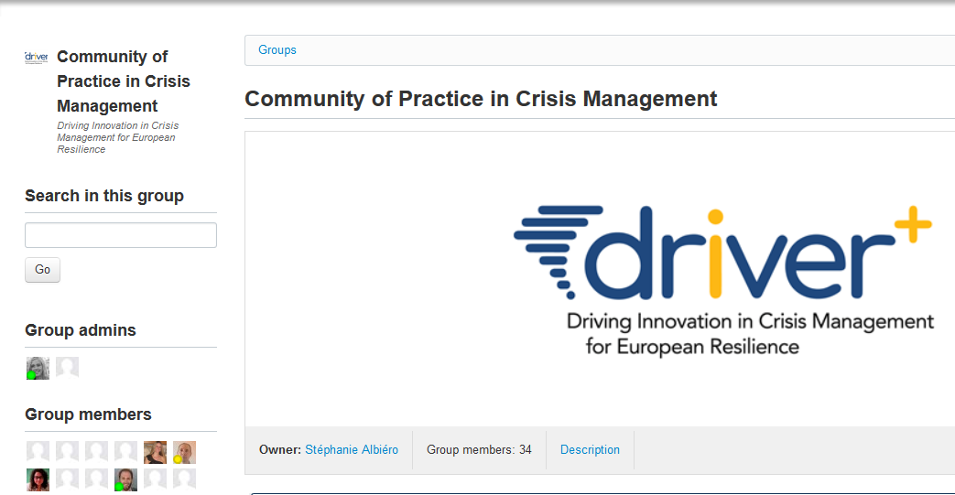





HOW TO JOIN AND HOW TO CONTRIBUTE?
Where to sign up?
Information on how to sign up for the external cooperation on all future DRIVER+ communications
The platforms for external cooperation will be subsets of the CoPCM, which is supported by the Online Communication Platform (OCP)
Dedicated groups will be created on the OCP
Preliminary version of the OCP
Dedicated CM experts
Practitioners
Solution providers
Available soon!
Exchange within and between the platforms

Slide 19
The Timeline
January 2018
Gaps & Needs assessment workshop
November 2019
Final Demo (Italy/Poland)
February 2018
Trials workshop 0 (Poland)
June 2018
I4CM#3 + Standardisation needs identification workshop (Poland)
December 2018
I4CM#4 (Denmark)
February 2020
Final Conference (Belgium)
2018
2019
2020
June 2018
Trial #1 (Poland)
October 2018
Trial #2 (France)
May 2019
Trial #3 (Austria)
October 2019
Trial #4 (The Netherlands)
February 2018
1st Policy-Research Dialogue Roundtable (Poland)
December 2018
2nd Policy-Research Dialogue Roundtable (Denmark)
February 2020
3rd Policy-Research Dialogue Roundtable (Belgium)

